Slide 1
AtliQ Grands Hospitality Analysis
Prepared by
Protyoy Pritam Goswami

Slide 2
About this project...
Atliq Grands owns multiple five-star hotels across India. They have been in the hospitality industry for the past 20 years. Due to strategic moves from other competitors and ineffective decision-making in management, Atliq Grands are losing its market share and revenue in the luxury/business hotels category. As a strategic move, the managing director of Atliq Grands wanted to incorporate “Business and Data Intelligence” in order to regain their market share and revenue. However, they do not have an in-house data analytics team to provide them with these insights.
Their revenue management team had decided to hire a 3rd party service(us) provider to provide them insights from their historical data.

Slide 3
AtliQ Grands Hotels Network
Mumbai
Atliq Seasons
Atilq Palace
Atliq Bay
Atliq Blu
Atliq City
Atliq Exotica
Atliq Grands
Delhi
Atilq Palace
Atliq Bay
Atliq Blu
Atliq City
Atliq Grands
Hyderabad
Atilq Palace
Atliq Bay
Atliq Blu
Atliq City
Atliq Exotica
Atliq Grands
Bangalore
Atilq Palace
Atliq Bay
Atliq Blu
Atliq City
Atliq Exotica
Atliq Grands

Slide 4
Requirements...
We had been provided with sample data and a mock-up dashboard to work on the following tasks.
Create the metrics according to the metric list.
Create a dashboard according to the mock-up provided by stakeholders.
Create relevant insights that are not provided in the metric list/mock-up dashboard.

Slide 5
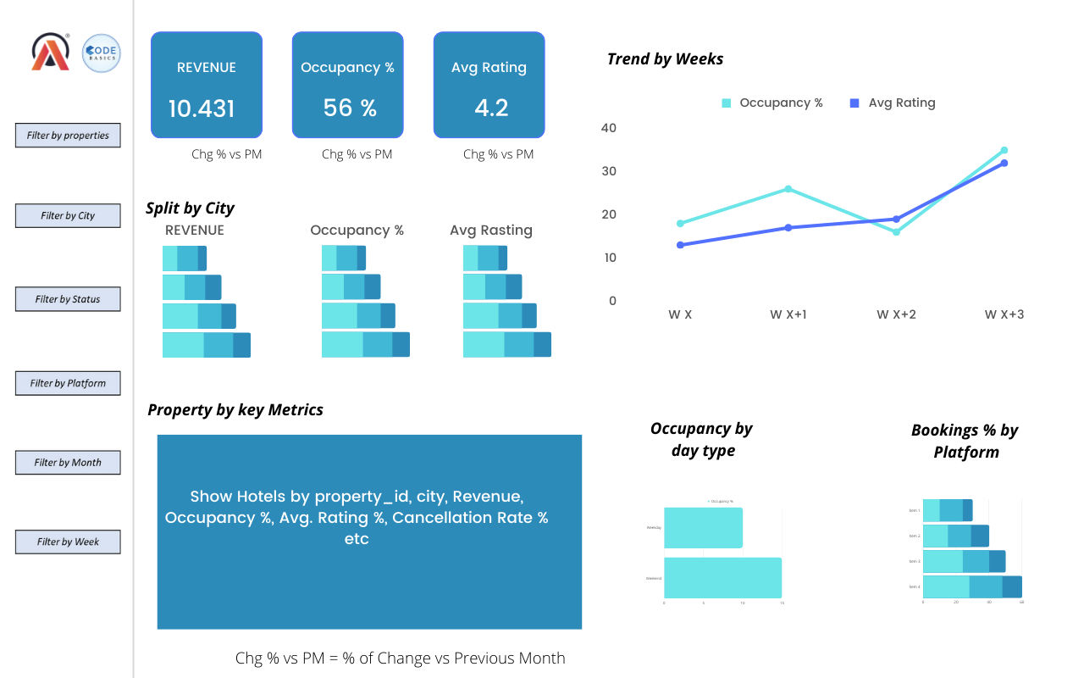
Mock up dashboard...

Slide 6
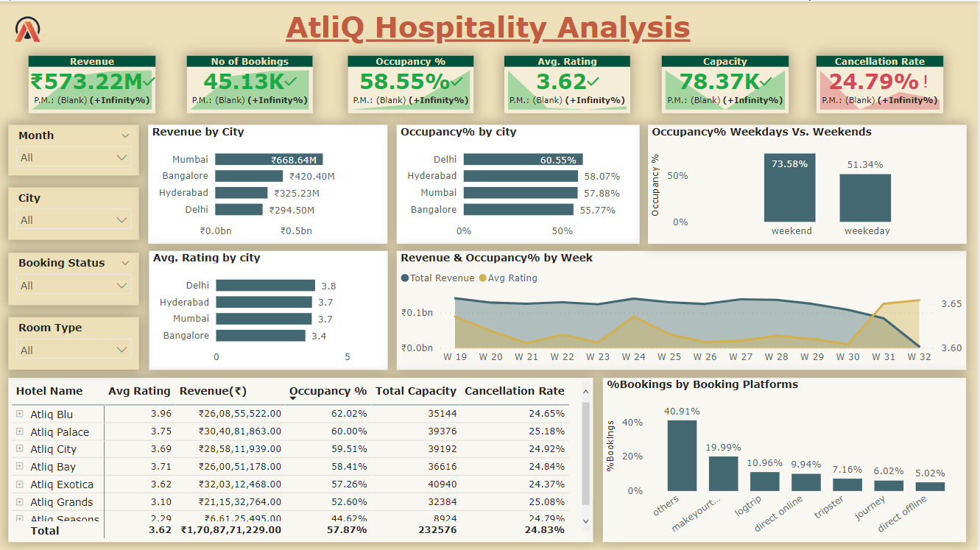
Prepared Dashboard...

Slide 7
Key Insights from Dashboard..
From the dashboard we have prepared using PowerBI, we gain some key insights as listed below.
Best Hotel by:
Revenue - Atliq Exotica (₹320 M) followed by Atliq Palace and Atliq City.
Avg. Rating - Atliq Blu (3.96) followed by Atliq Palace and Atliq Bay.
Occupancy% - Atliq Blu (62%) followed by Atliq Palace and Atliq City.
Overall - Atliq Exotica.

Slide 8
Key Insights from Dashboard..
From the dashboard we have prepared using PowerBI, we gain some key insights as listed below.
Best City by:
Revenue - Mumbai (₹669 M) followed by Bangalore and Hyderabad.
Avg. Rating - Delhi (3.8) followed by Hyderabad and Mumbai.
Occupancy% - Delhi (60.55%) followed by Hyderabad and Mumbai.

Slide 9
Key Insights from Dashboard..
From the dashboard we have prepared using PowerBI, we gain some key insights as listed below.
Total Revenue is decreasing month on month and fell by 12% in July'22.
Atliq Grands have lost ₹299 M in cancelled bookings.
Atliq Grands generated the most revenue through Elite type rooms (₹560 M).
Occupancy on weekend is 22% higher than occupancy on weekdays.

Slide 10
Future scope of this project...
We are planning to create sectorwise(Revenue, Ratings, Occupancy etc.) dashboards for more in depth and detailed analysis.
Any feedback on improvement and current dashboard are much appreciated.

Slide 11
Thank you all....

